Slide 1
Mennonite Mission Network requests prayer for the Bokgoni Sporting Club, in Francistown, Botswana, which offers young people an alternative to life on the streets by providing a healthy environment, training in life-skills and an opportunity to play sports. The women's netball team is planning a community day this month to strength relationships between neighbors.
^{September 7, 2025}

Slide 2


Slide 3
Kate Widmer, who serves with Mennonite Mission Network, is in the middle of her two-month North American Ministry. Pray for her as she shares with supporting congregations and individuals about her work alongside members of a French Mennonite congregation that reaches out to women and children in low-income neighborhoods. May she also find rest and renewal during this time in the United States.
^{September 14, 2025}

Slide 4


Slide 5
Mennonite Mission Network rejoices with members of the Bolivia Mennonite Church, as they celebrate their 50th anniversary. Pray for them as they set goals and plan for the future.
^{September 21, 2025}

Slide 6
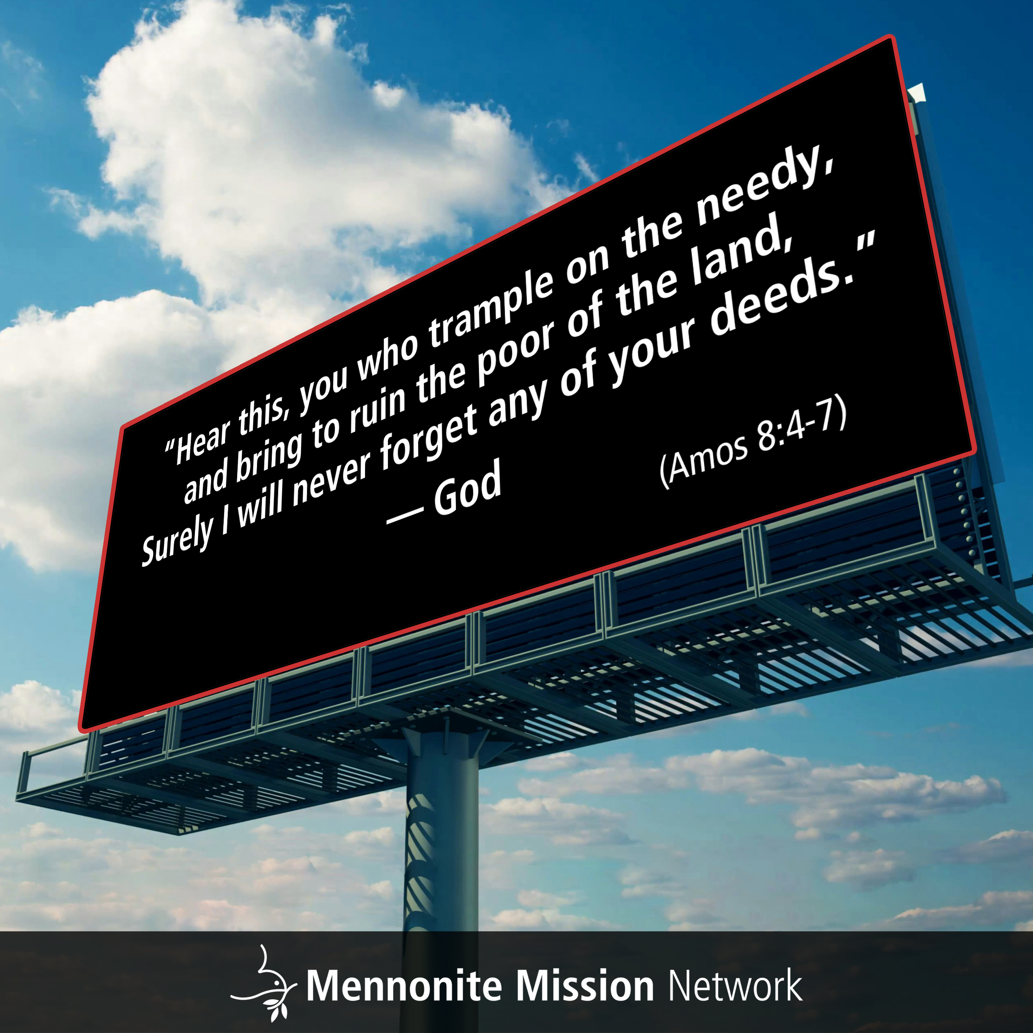

Slide 7
Pray that Mennonite Mission Network’s Mennonite Voluntary Service participants in San Francisco, California — Bella Kephart, Keyan Krabill, Emmi Scott and Ana Esperanza Neufeld Weaver, who is continuing for a second year — will build good rhythms of life, as they learn to live as a household, adjust to their service assignments and integrate into their host congregation, First Mennonite Church of San Francisco.
^{September 28, 2025}

Slide 8


