Slide 1
Delicia Bravo Aguilar and Peter Wigginton, who are serving with Mennonite Mission Network, request prayer for churches in Ecuador, as members are living in times of great uncertainty and violence. Pray for their protection, as they respond with faith and integrity, naming and resisting the forces of fear and apathy. Pray also for Delicia, Peter and their two daughters as they walk alongside these churches.
^{November 2, 2025}

Slide 2


Slide 3
Mennonite Christian Hospital (MCH), in Hualien, Taiwan, was among the first to respond when Typhoon Ragasa devastated villages and caused flooding in their region in September. Pray that MCH personnel will be able to share Jesus’ love, as they continue to care for those who were injured, those who lost loved ones and all who were traumatized by the storm’s destruction.
^{November 9, 2025}

Slide 4
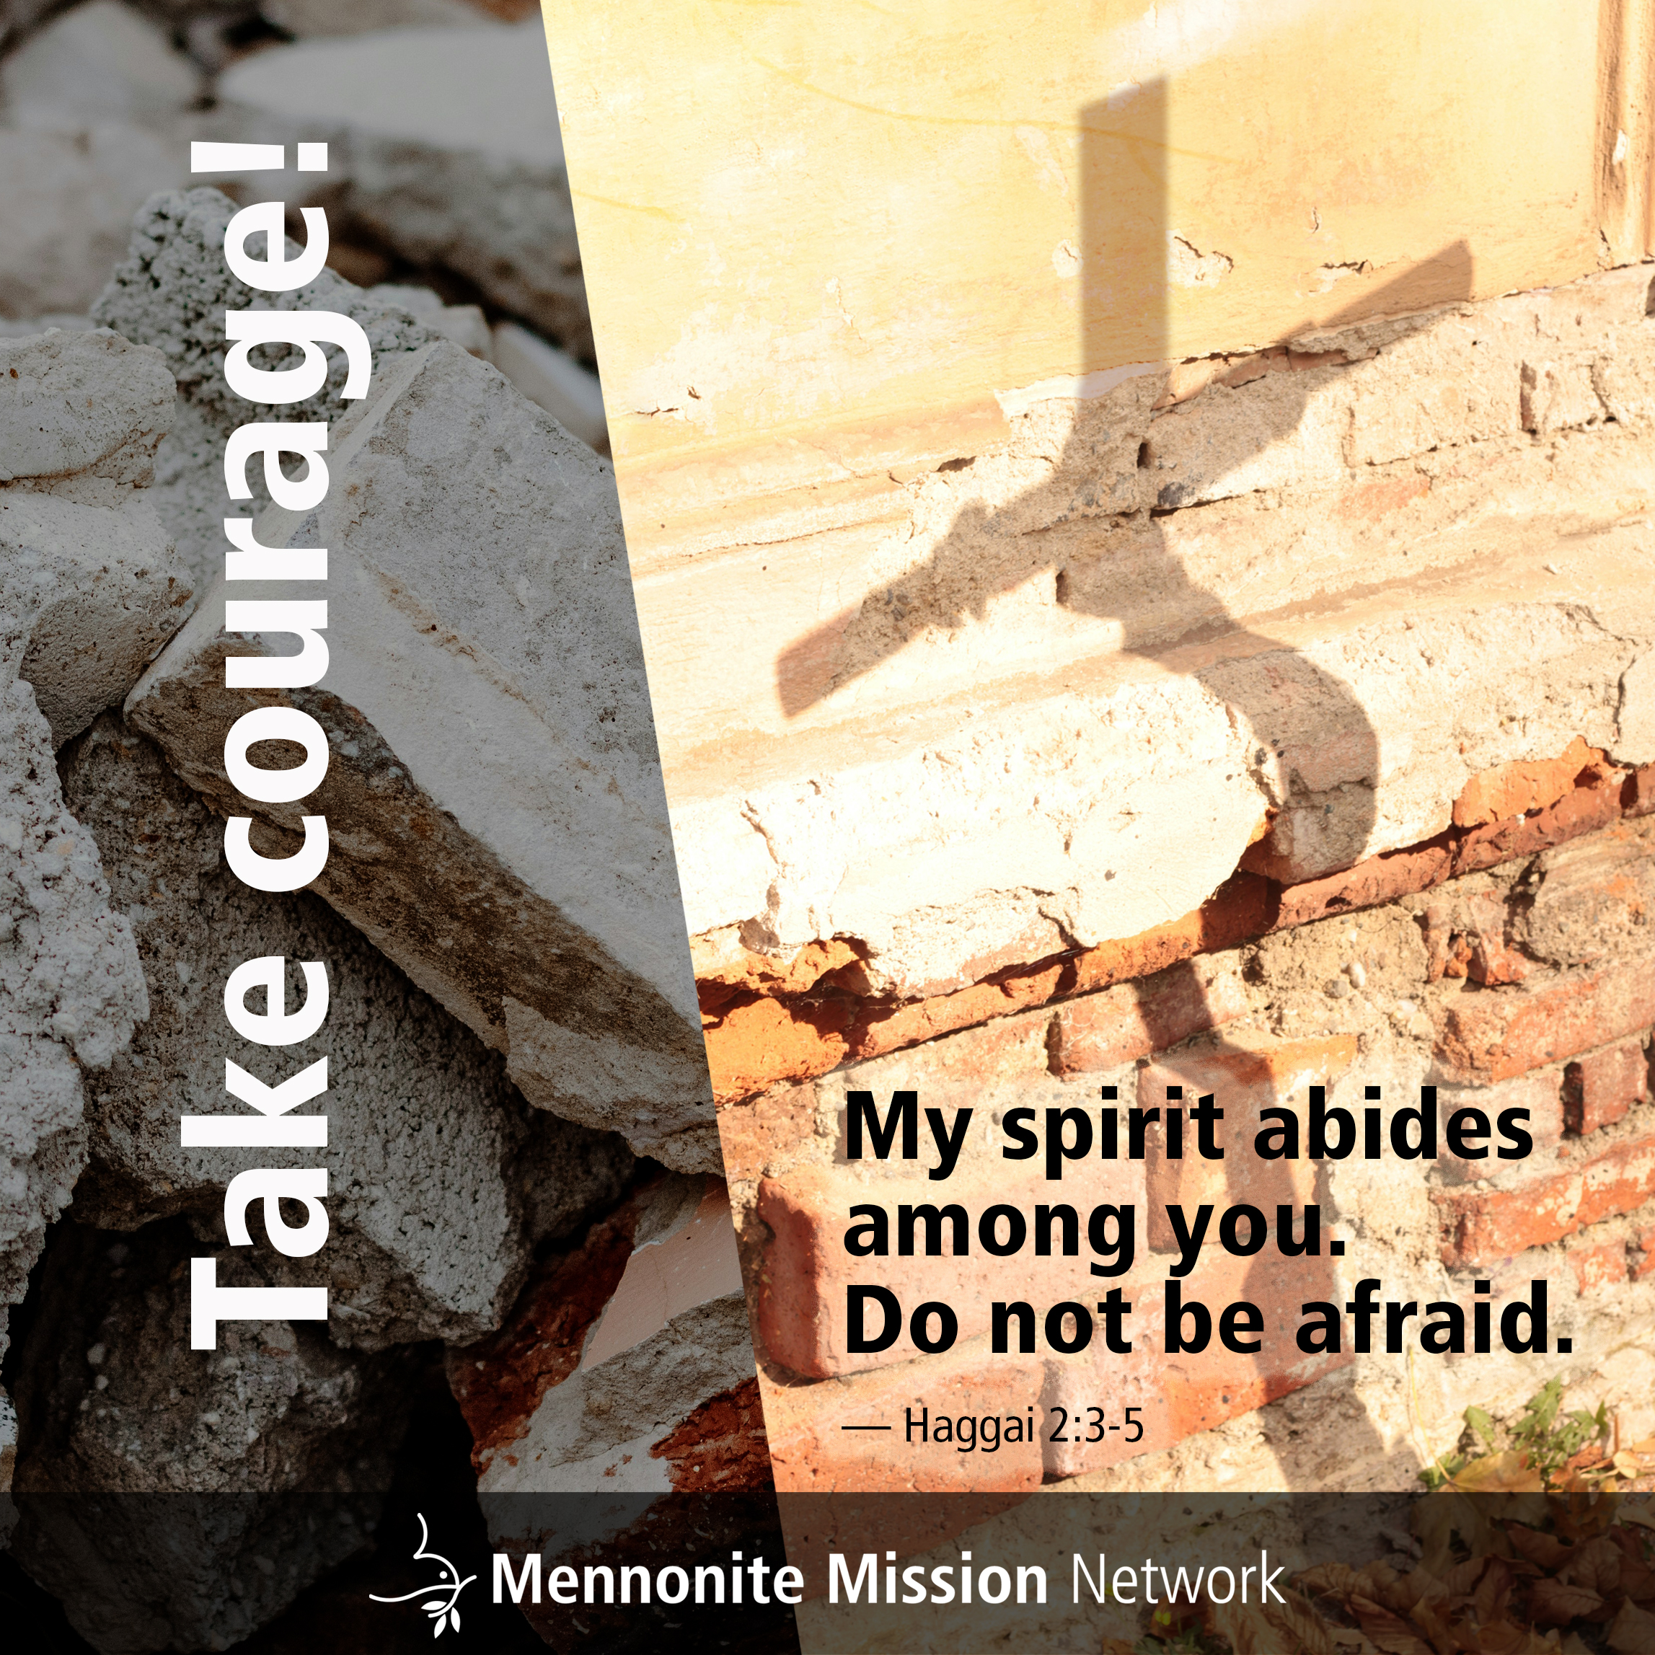

Slide 5
Mennonite Mission Network is actively recruiting young people to participate in service programs beginning in August 2026. Pray that those whom God is calling to sign up for Mennonite Voluntary Service — with units in Arizona, California and Colorado — and Service Adventure — with units in Alaska and Colorado — will say yes.
^{November 16, 2025}

Slide 6


Slide 7
Anicka Fast, who serves with Mennonite Mission Network and Mennonite World Conference, is working on the first volume of the Global Anabaptist Forebears series, a joint effort between Boston University’s Center for Global Christianity and Mission, Mission Network and Mennonite World Conference. Pray for inspiration and stamina as Anicka edits the series, conducts history-writing workshops and seeks funding.
^{November 23, 2025}

Slide 8


Slide 9
Mennonite Mission Network requests prayer for Jonah and Memee Yang, as they offer trainings in Southeast Asia that focus on discipleship, equipping youth and families, and holistic community building. Pray for Jonah, as he teaches Anabaptist Mennonite Biblical Seminary’s Journey Missional Leadership Development program, and for Memee, as she works with women, using the Sister Care curriculum.
^{November 30, 2025}

Slide 10


