Slide 1
Praise God that after nearly a year of chemo treatments, Caleb Schrock-Hurst is cancer free! Caleb and Stephanie plan to move to Taiwan early this year to serve with Mennonite Christian Hospital in Hualien.
^{January 4, 2026}

Slide 2


Slide 3
As Ben and Laurel Woodward-Breckbill begin their second two-year term at the Paris (France) Mennonite Center, pray for discernment about how to best use Laurel’s gifts in the various ministries she works with.
^{January 11 , 2026}

Slide 4
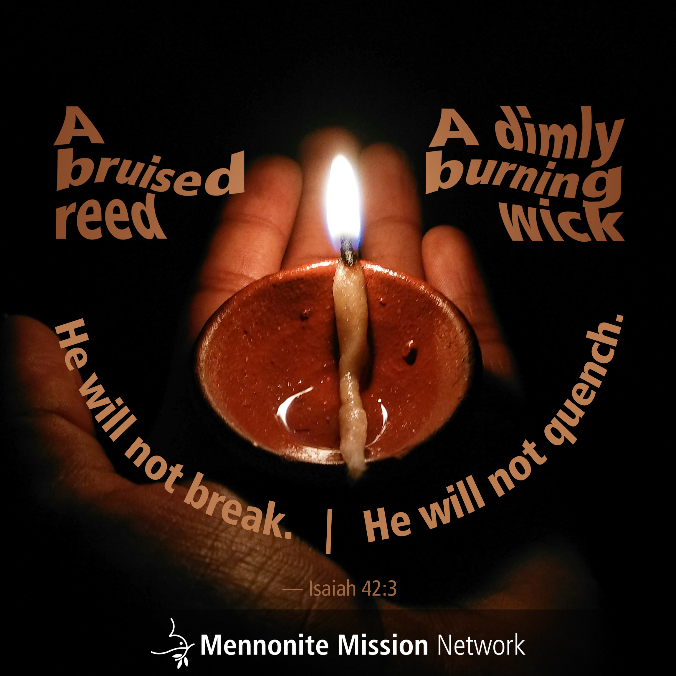

Slide 5
Service Adventure unit leaders are meeting this week for their midyear retreat in Colorado Springs, Colorado. Pray that these leaders experience refreshment, rejuvenation and good discussions as they meet together.
^{January 18, 2026}

Slide 6
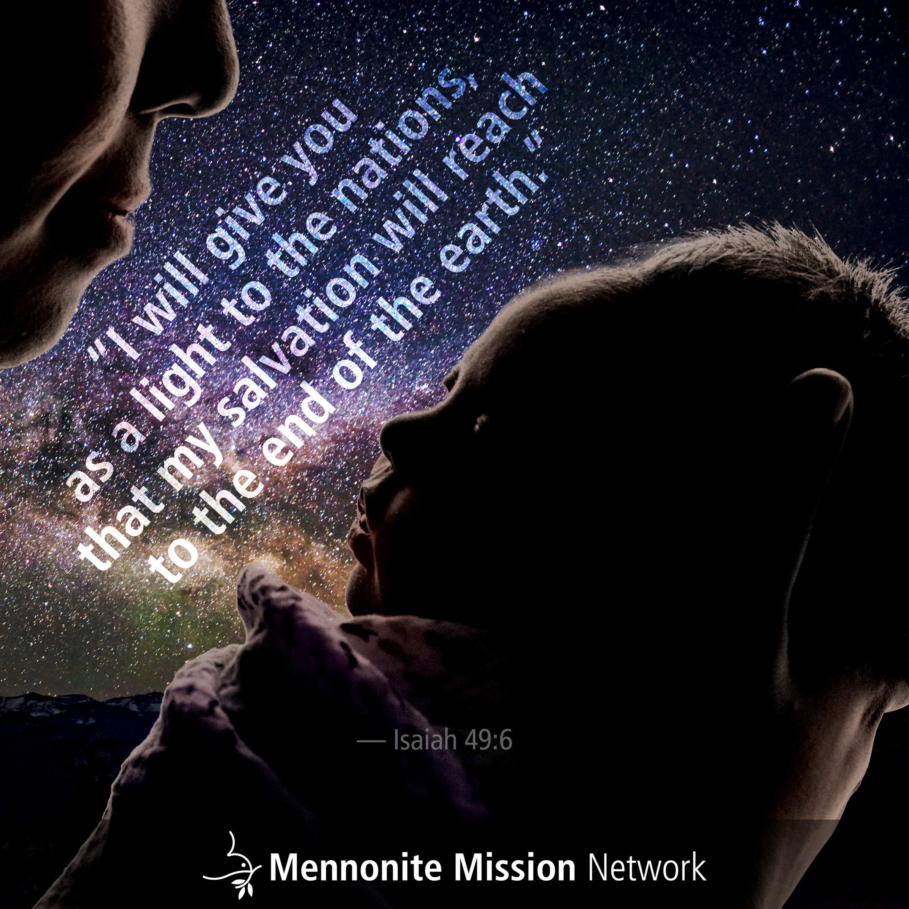

Slide 7
The Taiwan Mennonite New Dawn Educare Center brings God’s hope to people with intellectual disabilities by providing resources to help with independent living, personal development and health. Pray that the people they serve find belonging, purpose and hope.
^{January 25, 2026}

Slide 8


