Slide 1
Pray for the people of Venezuela, and Mennonite Mission Network’s partner Network of Mennonite Missions of Venezuela, amid the political instability caused by the forceful removal of Venezuela’s president by the U.S. last month. Pray that the new governmental leaders will reflect the will of the Venezuelan people and bring peace to the country.
^{February 1, 2026}

Slide 2


Slide 3
Last week, Julia and Thomas Meyers began their four-week SOOP placement at the Maria Skobtsova House (MSH) in Calais, France. Pray for them as they share in MSH’s ministry of hospitality to migrants who are seeking refuge while on their way to England.
^{February 8, 2026}

Slide 4
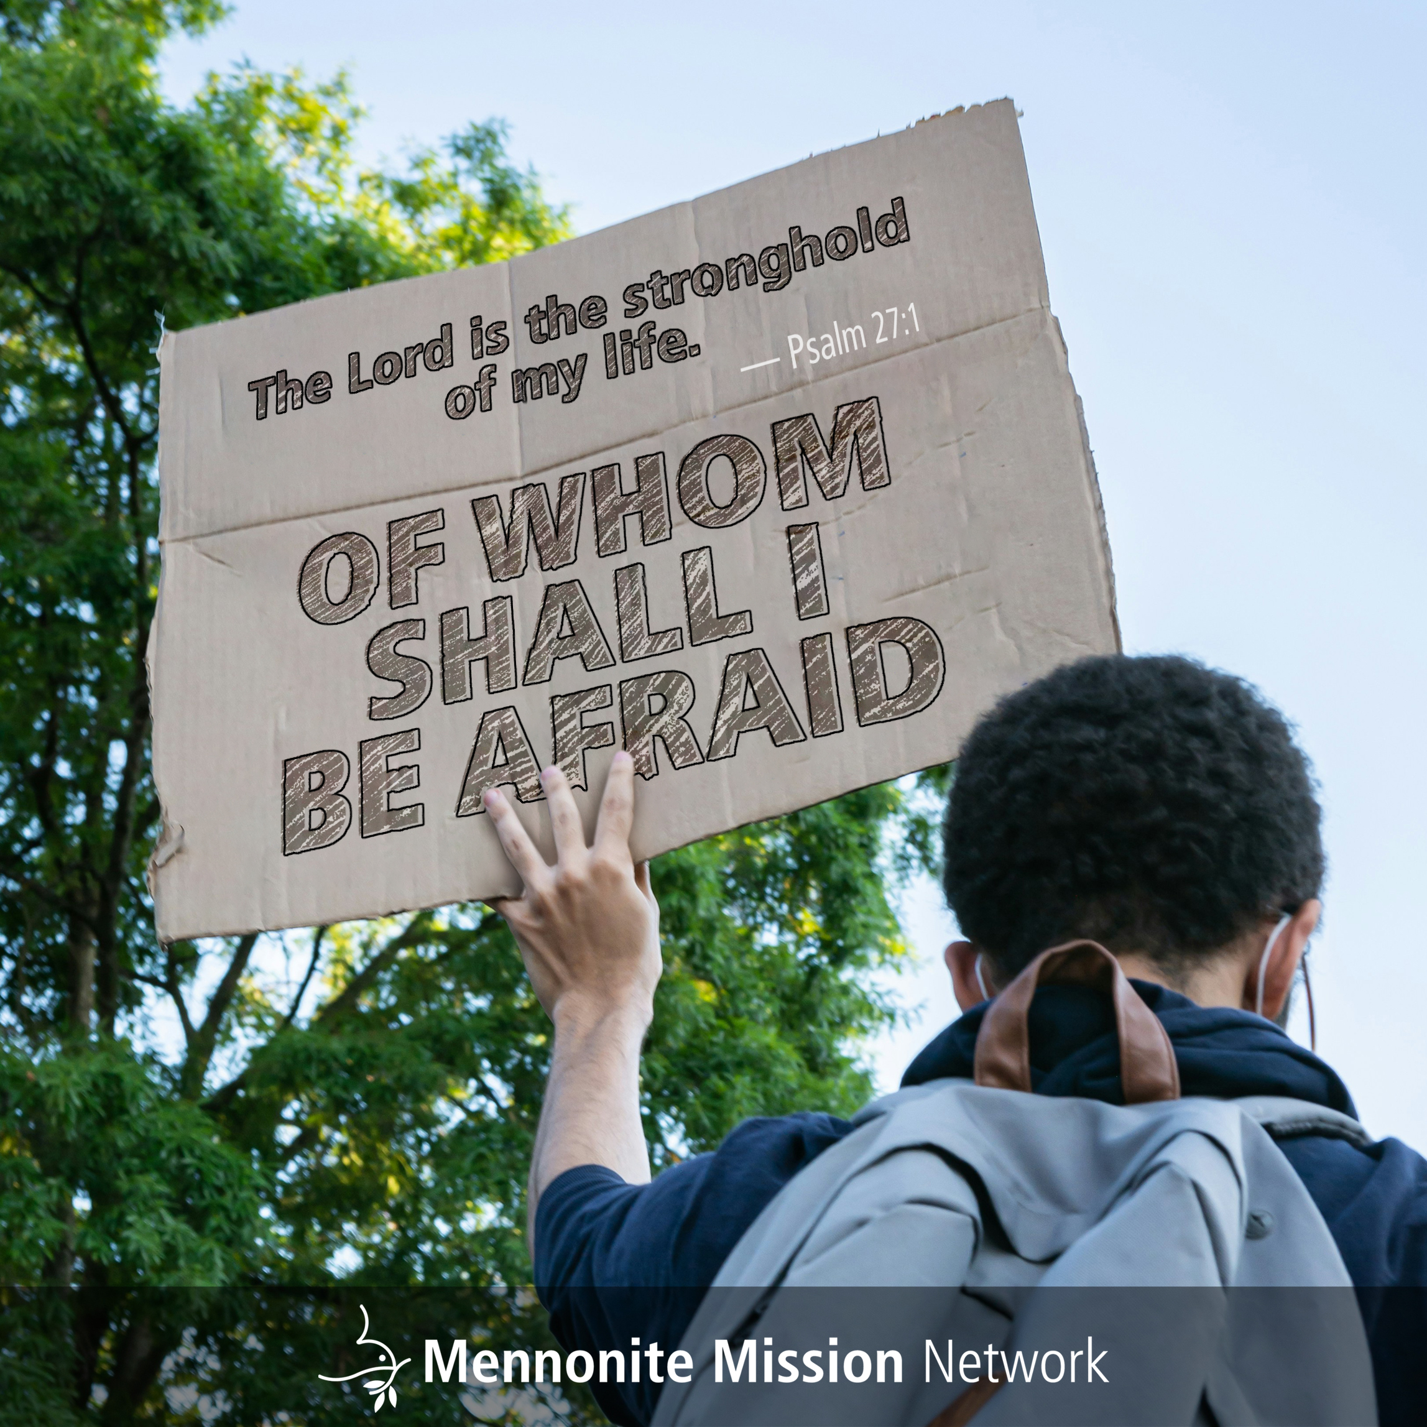

Slide 5
Last fall, Christy Harrision, Peter Sensenig and their three children temporarily moved to Montbéliard, France, from Chad, after their Chadian visas were not renewed, due to the political relationship between the U.S. and Chad. Pray for this family as they acclimate to their new home and ministry and as they navigate how to proceed if they are unable to return to Chad in the future.
^{February 15, 2026}

Slide 6


Slide 7
Anicka Fast trains and mentors historians and archivists in Africa, Asia and Latin America, to help promote a recognition of global Anabaptist history. She and her family currently reside in the Netherlands but are planning to move back to Canada this summer. Pray for heartwarming farewells as they prepare for their move and a smooth transition into their new home, especially for the children and their schooling.
^{February 22, 2026}

Slide 8


