Slide 1
Today, we celebrate Easter and the hope brought by the risen Christ amid a world that seems more chaotic and destructive every day. Pray that God’s people would remember to be “Easter people” every day, displaying the love of Jesus through the everyday acts of seeking justice, doing service and hoping for a better future.
^{April 5, 2026}

Slide 2


Slide 3
This week, four SOOP participants will begin two-week assignments at Hesston (Kansas) College and Iglesia Cristiana Roca de Refugio in San Antonio, Texas. Additionally, another couple will wrap up a one-month SOOP placement in Calais, France, this week. Praise God for the willingness of these participants to give of their time and talents.
^{April 12, 2026}

Slide 4
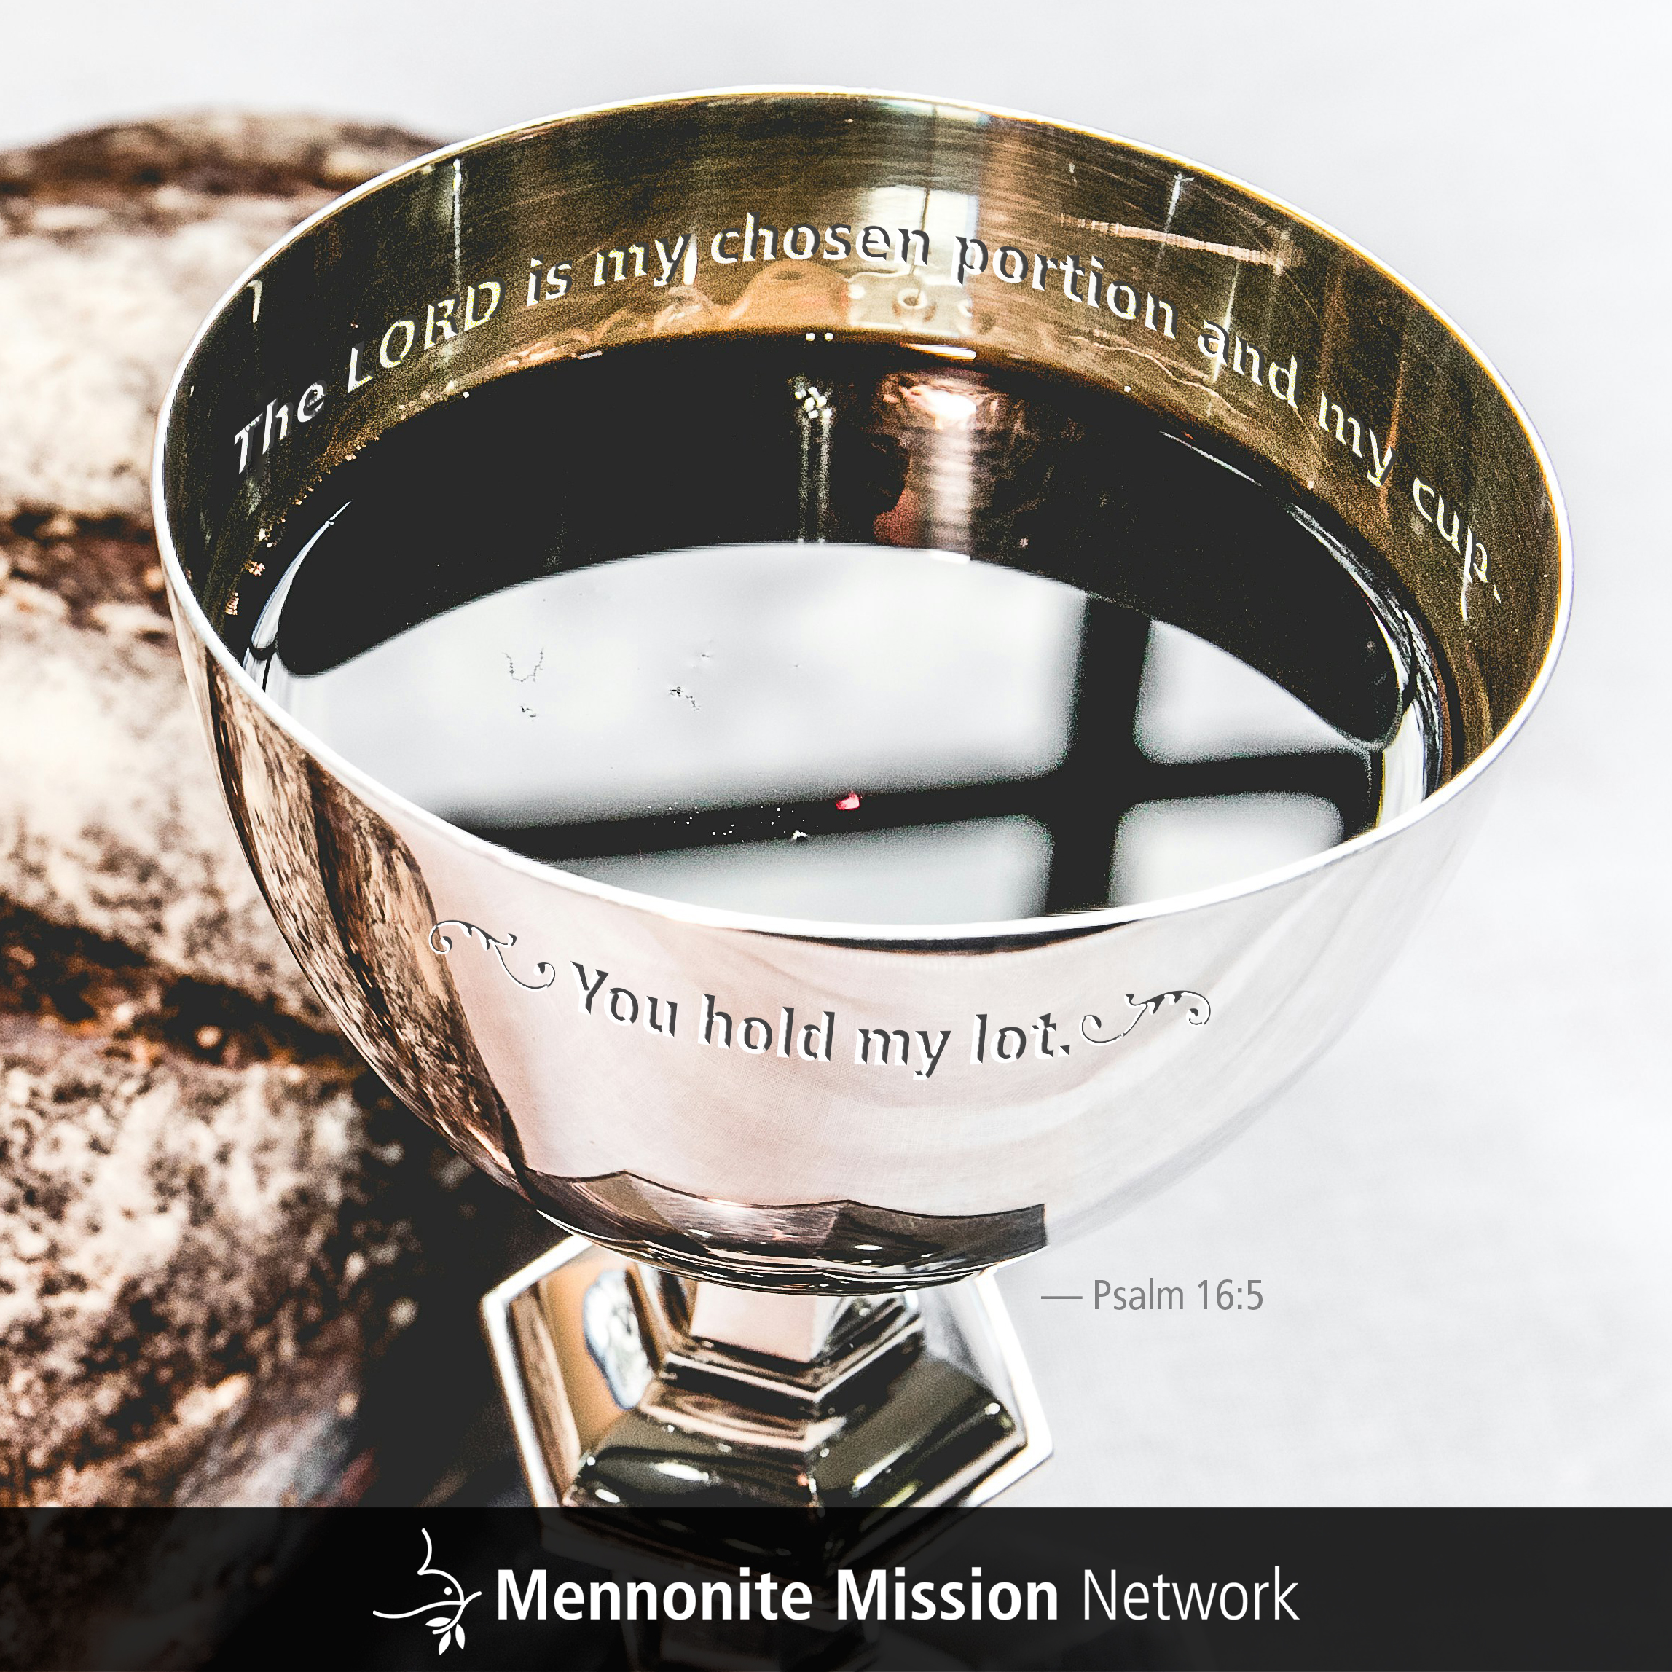

Slide 5
Caleb and Stephanie Schrock-Hurst have been onsite at Mennonite Christian Hospital (MCH) in Hualien, Taiwan, for more than two months. Pray that the Bible study they are now leading with MCH staff will be a fruitful and fulfilling time of study and fellowship for all involved.
^{April 19, 2026}

Slide 6


Slide 7
Laura and Nick Sharp, and their two children, are nearing the end of their one-year service term in La Mesa, Colombia, where they offer educational support at the Colegio Americano Menno. Pray that they are able use these final two months in Colombia to continue the relationships they have built, while also preparing themselves and the children they help teach for their inevitable good-byes.
^{April 26, 2026}

Slide 8


