Slide 1
Austin Roberts has successfully completed his final revision to his dissertation and has returned to work at Youth With A Mission in Rostrevor, Northern Ireland. Pray for him as he discerns what this new phase of life will look like. Pray also that his application for British citizenship will be approved.
^{May 3, 2026}

Slide 2
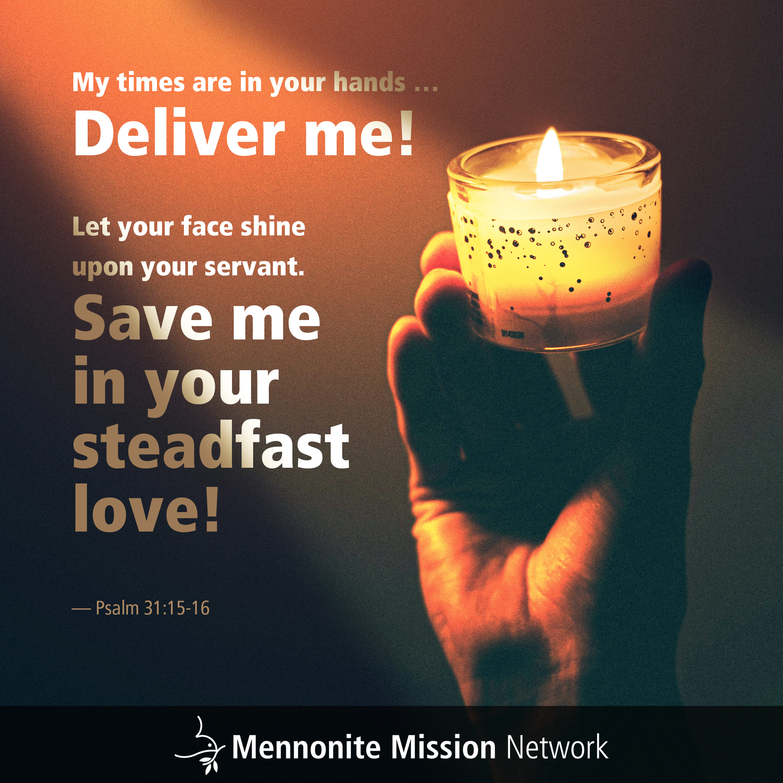

Slide 3
This Mother’s Day, pray for all those who experience pain or grief due to loss, broken relationships or a yearning to become a parent. Pray that they would find comfort and love in the warm embrace of our heavenly parent.
^{May 10, 2026}

Slide 4


Slide 5
Michael Bergen and Sam Abrahams participate in the Colorado Springs (Colorado) Service Adventure unit and serve the local community through interactions with adults with intellectual and developmental disabilities and helping low-income families keep their homes warm, safe and well-maintained.
^{May 17, 2026}

Slide 6


Slide 7
The Venezuela Global Mission Partnership supports the Network of Mennonite Missions of Venezuela. Pray for their ministries in church planting, biblical and theological education, and food distribution to people in need.
^{May 24, 2026}

Slide 8


Slide 9
Menno Village is an 80-acre farm near Sapporo, Japan, that emphasizes sustainable agriculture and provides food for their neighbors via a community supported agriculture program. Pray that this ministry is able to challenge the systems that exploit people and land by caring for all creation.
^{May 31, 2026}

Slide 10
