Slide 1
Laura and Nick Sharp, and their two children, are nearing the end of their time in Colombia. Pray for this family as they navigate the difficulties of leaving behind the friends and culture they have grown to love, while also eagerly anticipating being reunited with their friends, family and home in Kansas.
^{June 7, 2026}

Slide 2
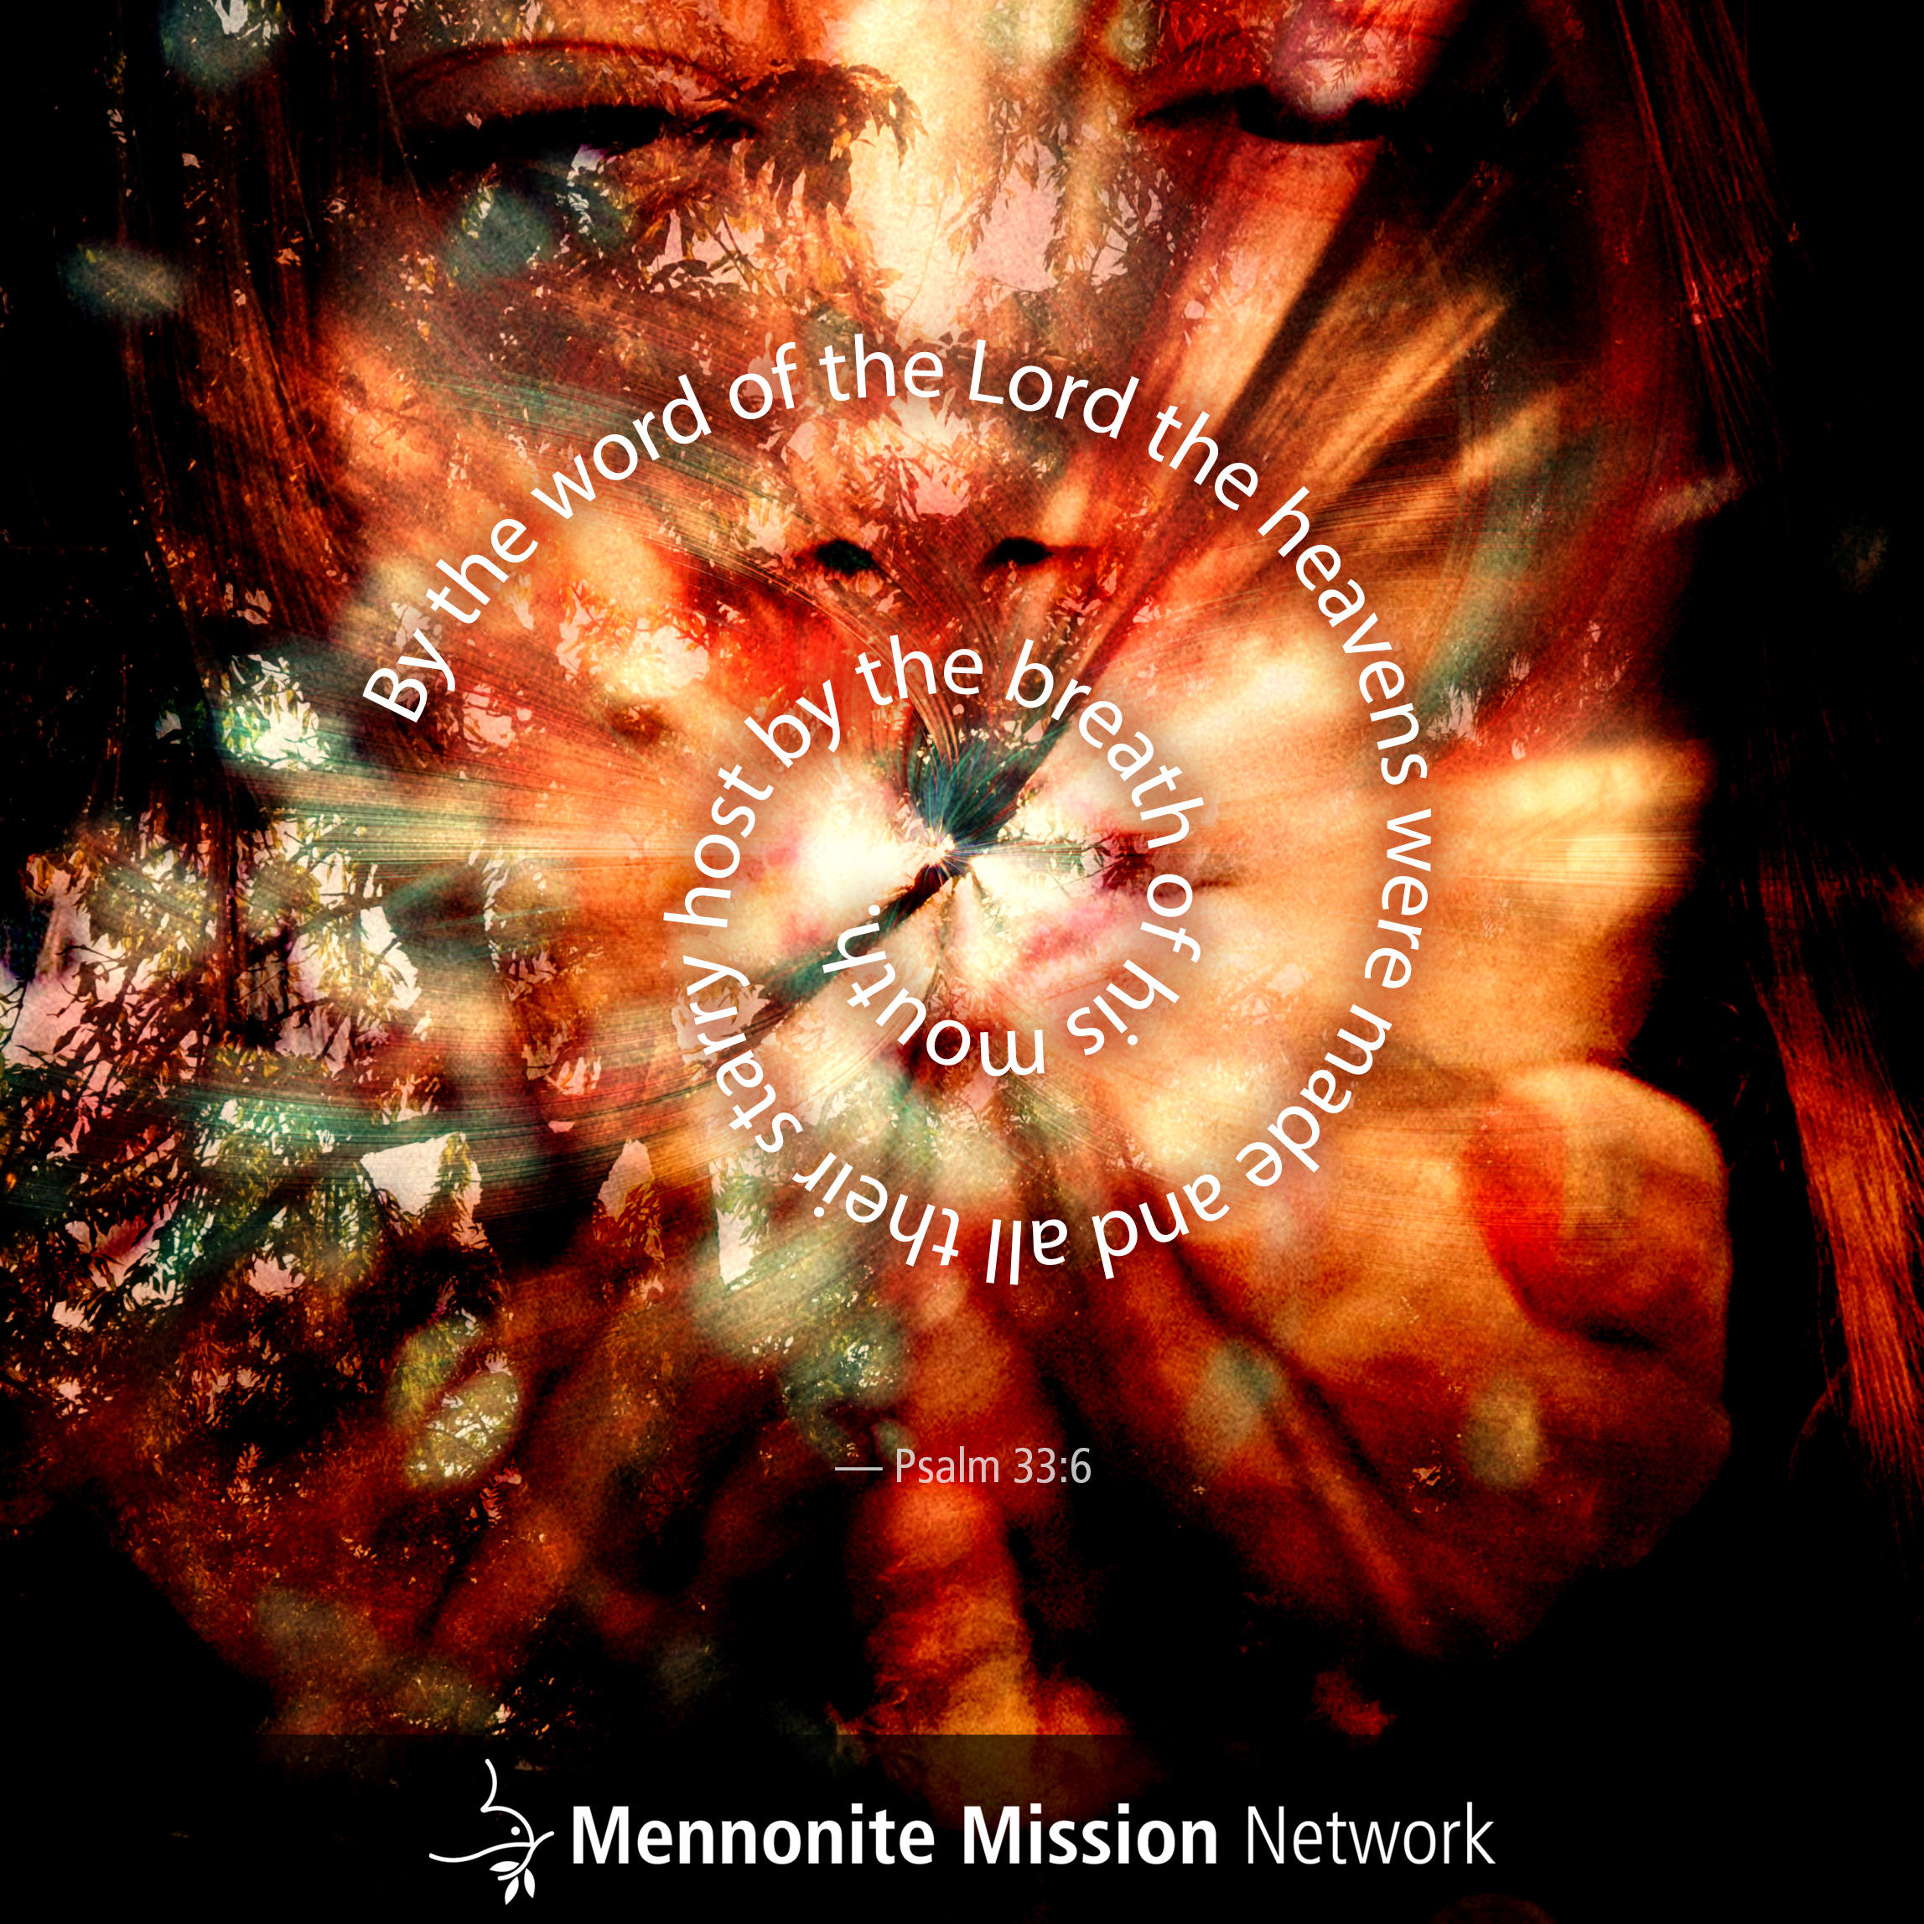

Slide 3
This month, the participants in the Service Adventure units in Anchorage, Alaska, and Colorado Springs, Colorado, will complete their individual service placements, go on their year-end trip and end their term together. Pray that this final month will be a fulfilling time of fellowship and work, as they say goodbye to their new friends.
^{June 14, 2026}

Slide 4


Slide 5
Today, as people in the United States celebrate the father figures in their lives, pray that those who do not have a father to celebrate with will find solace in the love and sacrifice that our heavenly parent has freely given to all.
^{June 21, 2026}

Slide 6


Slide 7
Ben and Laurel Woodward-Breckbill are serving as the directors of the Paris (France) Mennonite Center. They and their two children will soon be traveling back to the United States for their two-month North American Ministry. Pray for them as they spend July visiting churches and supporters on a cross-country road trip, and August in Kansas.
^{June 28, 2026}

Slide 8


