Slide 1
Joseph and Rachel Givens are shifting away from working at the Maria Skobtsova House and beginning to work with new partners in the Calais, France, area. Pray for them during this time of transition.
^{August 2, 2026}

Slide 2


Slide 3
The Service Adventure unit in Colorado Springs, Colorado, begins today, with new unit leaders Elliot and Jane Radzanowski. Pray for the new leaders and this year’s participants as they settle into their year of service away from friends and family.
^{August 9, 2026}

Slide 4


Slide 5
On June 24, Venezuela experienced two devastating earthquakes that resulted in the confirmed death or injury of more than 20,000 people, with tens of thousands more still missing. Pray for everyone affected, as they continue to mourn the lost, search for the missing and rebuild.
^{August 16, 2026}

Slide 6


Slide 7
Christy Harrison, Peter Sensenig and their three children are relocating from Montbéliard, France, to Beruit, Lebanon, this month. This will be their second move to a new continent in under two years. Pray for them as they transition into their new home and say goodbye to the friends they made in France.
^{August 23, 2026}

Slide 8
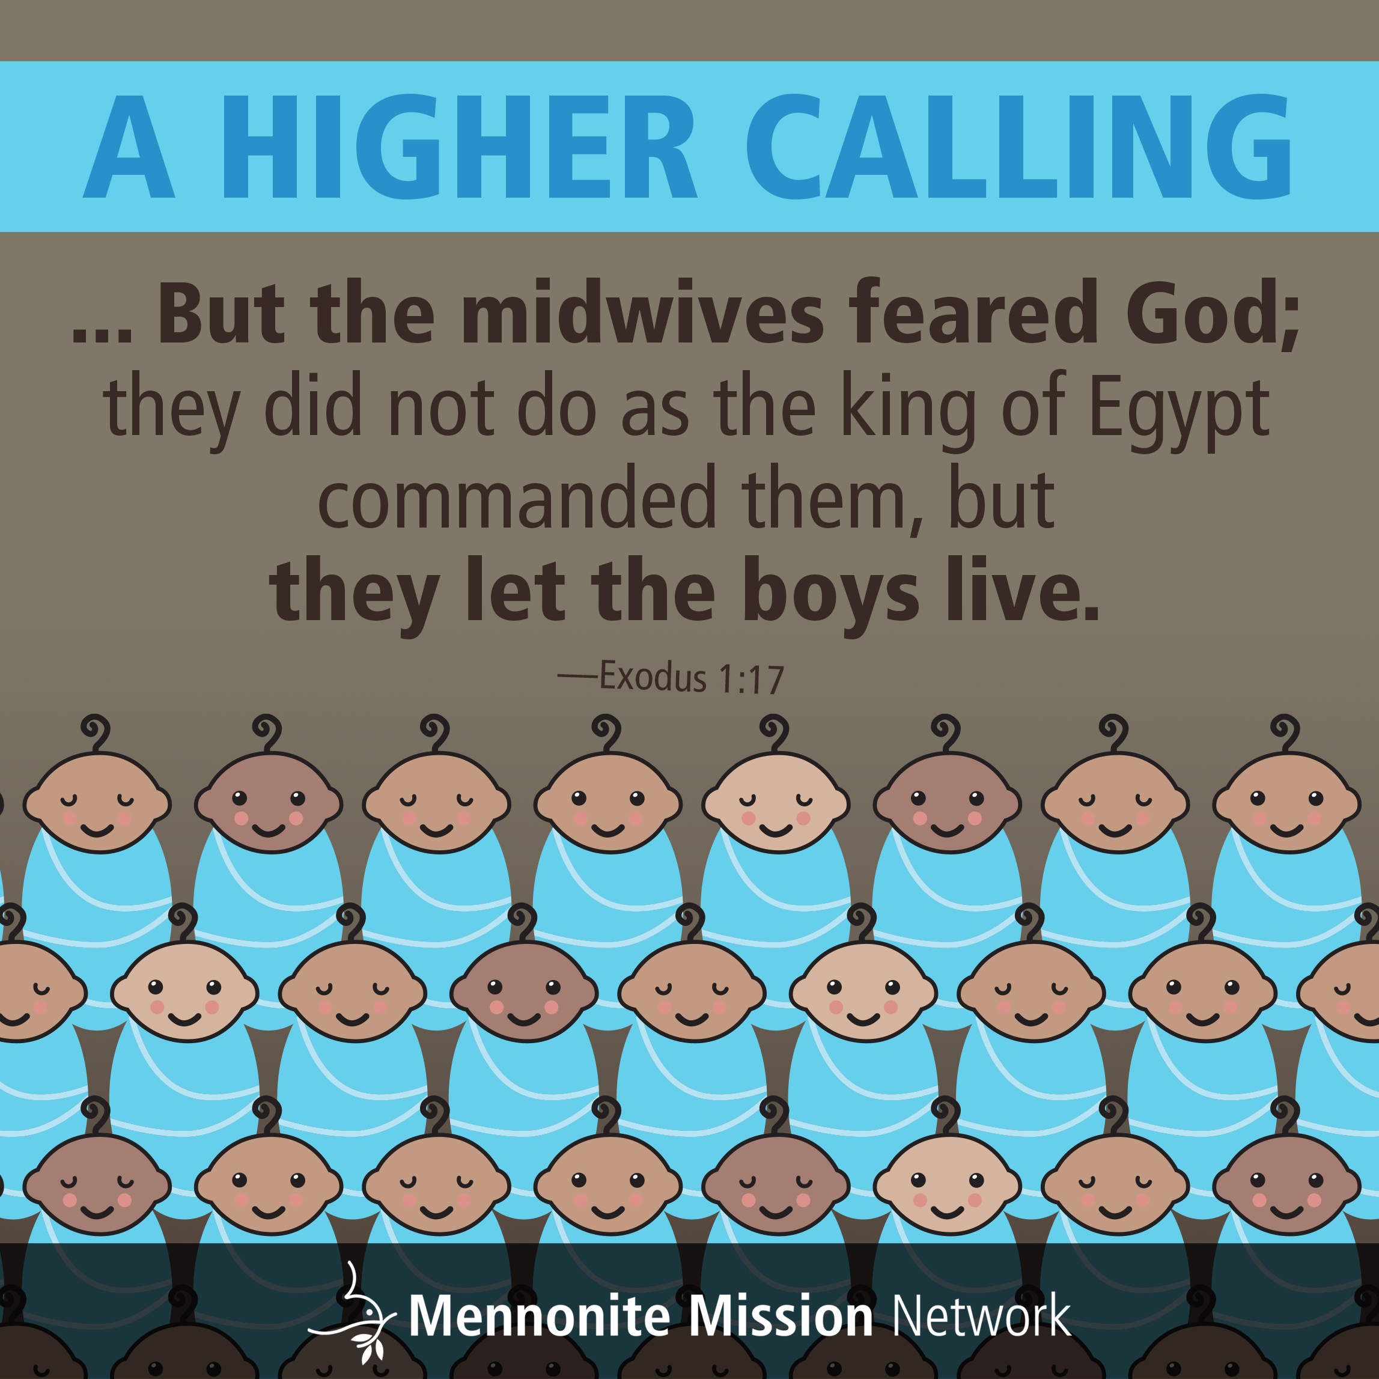

Slide 9
Laura and Nick Sharp and their two children have completed their year of service in La Mesa, Colombia, and have returned to their home in Kansas. Pray for this family as they transition back into life in the U.S. and as they solidify plans for this next stage of life.
^{August 30, 2026}

Slide 10


