Slide 1
South Sudan has been experiencing escalating conflict, ecological disaster, economic decline, widespread displacement and mass immigration, which has created immense stress for the small country. Pray for immediate support for the South Sudan Mennonite Church and other organizations to be able to provide basic food items to vulnerable households.
^{September 6, 2026}

Slide 2


Slide 3
Praise God that SEMILLA is now offering a diploma in the Bible, leadership and youth ministry for young Mennonites. Pray for students participating in this program, whose classes began last week.
^{September 13, 2026}

Slide 4


Slide 5
The Northeast Asia Regional Peacebuilding Institute (NARPI) introduced its new youth initiative, Beyond Borders, at the NARPI Summer Peacebuilding Training last month. Pray for the youth and young adults in this program as they engage in intercultural dialogue, mentoring, networking and self-care practices.
^{September 20, 2026}

Slide 6
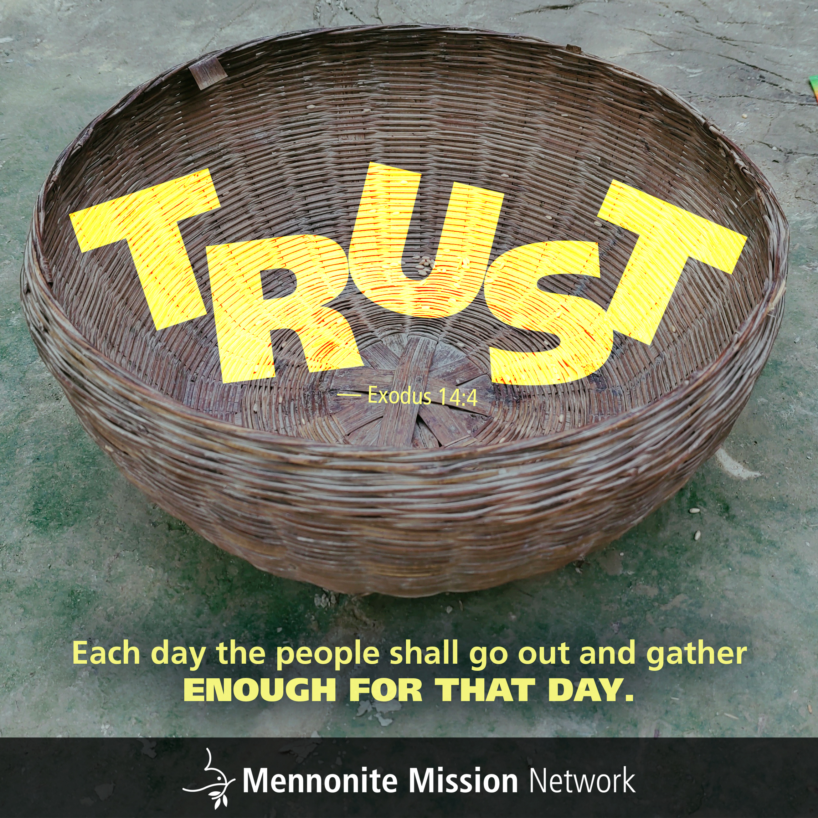

Slide 7
A group from Eden Mennonite Church, in Moundridge, Kansas, begins their week-long Civil Rights Just Peace Pilgrimage this week. Pray for participants as they travel through the southern U.S., learning about racism and the Civil Rights Movement from historical sites, museums and first-hand accounts. Pray that this experience will inspire participants to enact change in their own communities.
^{September 27, 2026}

Slide 8


